Slide 1


Department of BES 1
COURSE NAME :DATA STRUCTURES
COURSE CODE
Topic:
CIRCULAR QUEUE
Session - 18

Slide 2



AIM OF THE SESSION
To familiarize students with the basic concept of Circular queue
INSTRUCTIONAL OBJECTIVES
This Session is designed to:
Demonstrate the properties of Circular queues
Describe the operations of Circular queues
List out the types of Circular queues
Describe the difference between Circular queue and normal queue
LEARNING OUTCOMES
At the end of this session, you should be able to:
Define Circular queue
Describe properties and operation of Circular queues
Summarize priority queue concepts

Slide 3
CIRCULAR QUEUE INTRODUCTION
DEFINITION:
A circular queue, also called a Ring Buffer, is a data structure that operates on the First In, First Out (FIFO) principle, just like a linear queue. However, unlike a linear queue, the last position in a circular queue is connected back to the first position, forming a continuous loop. This circular connection ensures efficient utilization of space by reusing empty slots created when elements are dequeued.

Slide 4
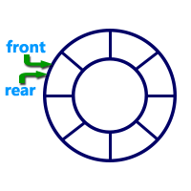
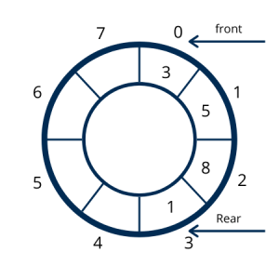
Graphical representation of a circular queue is as follows...
CIRCULAR QUEUE IMAGE

Slide 5
PROPERTIES OF CIRCULAR QUEUE
1.Fixed Size:
A circular queue has a fixed size, means maximum number of elements it can hold is determined when it is created.1.
2.FIFO Principle:
Like a linear queue, it follows the First In, First Out (FIFO) principle, where elements are inserted at the rear and removed from the front.
3.Circular Nature:
The last position in the queue is connected to the first position, creating a circular structure. This eliminates the need to shift elements after a dequeue operation.
4. Efficient Space Utilization:
Unlike a linear queue, a circular queue makes use of all available slots, reusing the spaces freed up when elements are dequeued.
5. Two Pointers (Front and Rear):
These pointers help in efficiently tracking and managing the circular nature of the queue.

Slide 6
CIRCULAR QUEUE INTRODUCTION
Members of Circular Queue:
Here are the members and the functions or process that can be done in a Circular Queue.
Space Complexity Reduction : Circular queue is more manageable than linear queue in terms of space complexity.
Computer Controlled Traffic System : Computer uses Circular queue to control the traffic system.
Process Scheduling : CPU uses Circular Queue or Queues to schedule processes.
Memory Management : Memory can be managed by a fixed length circular buffer, that is an application of Circular Queue.
Repetitions in Calendar : Days in Week, Sun-Mon-Tues or n Months in year, Jan-Feb-Mar or repetitive situations like that can be implemented using Circular Queue, that comes in first in first out basis with a fixed length.
Circular Manufacturing Machines : Circular Machines like Bottle capping systems use fixed length Circular Queue.

Slide 7
OPERATIONS OF A CIRCULAR QUEUE
CIRCULAR QUEUE SUPPORTS THE FOLLOWING OPERATIONS
Insertion in a Circular queue
Deletion in a Circular queue
Peek in a Circular queue

Slide 8
INSERTION IN CIRCULAR QUEUE
Enqueue(value) –
Inserting value into the Circular Queue
Step 1 :- Check whether queue is FULL. ((rear == SIZE-1 && front == 0) || (front == rear+1))
Step 2 :- If it is FULL, then display "Queue is FULL!!! Insertion is not possible!!!" and terminate the function.
Step 3: - If it is NOT FULL, then check rear == SIZE - 1 && front != 0 if it is TRUE, then set rear = -1.
Step 4 :- Increment rear value by one (rear++), set queue[rear] = value and check 'front == -1' if it is TRUE, then set front = 0.

Slide 9
DELETION IN CIRCULAR QUEUE
Dequeue()
Deleting a value from the Circular Queue
Step 1 - Check whether queue is EMPTY. (front == -1 && rear == -1)
Step 2 - If it is EMPTY, then display "Queue is EMPTY!!! Deletion is not possible!!!" and terminate the function.
Step 3 - If it is NOT EMPTY, then display queue[front] as deleted element and increment the front value by one (front ++). Then check whether front == SIZE, if it is TRUE, then set front = 0. Then check whether both front - 1 and rear are equal (front -1 == rear), if it TRUE, then set both front and rear to '-1' (front = rear = -1).

Slide 10
DISPLAY IN CIRCULAR QUEUE
display()
Displays the elements of a Circular Queue
Step 1 - Check whether queue is EMPTY. (front == -1)
Step 2 - If it is EMPTY, then display "Queue is EMPTY!!!" and terminate the function.
Step 3 - If it is NOT EMPTY, then define an integer variable 'i' and set 'i = front'.
Step 4 - Check whether 'front <= rear', if it is TRUE, then display 'queue[i]' value and increment 'i' value by one (i++). Repeat the same until 'i <= rear' becomes FALSE.
Step 5 - If 'front <= rear' is FALSE, then display 'queue[i]' value and increment 'i' value by one (i++). Repeat the same until'i <= SIZE - 1' becomes FALSE.
Step 6 - Set i to 0.
Step 7 - Again display 'cQueue[i]' value and increment i value by one (i++). Repeat the same until 'i <= rear' becomes FALSE.

Slide 11
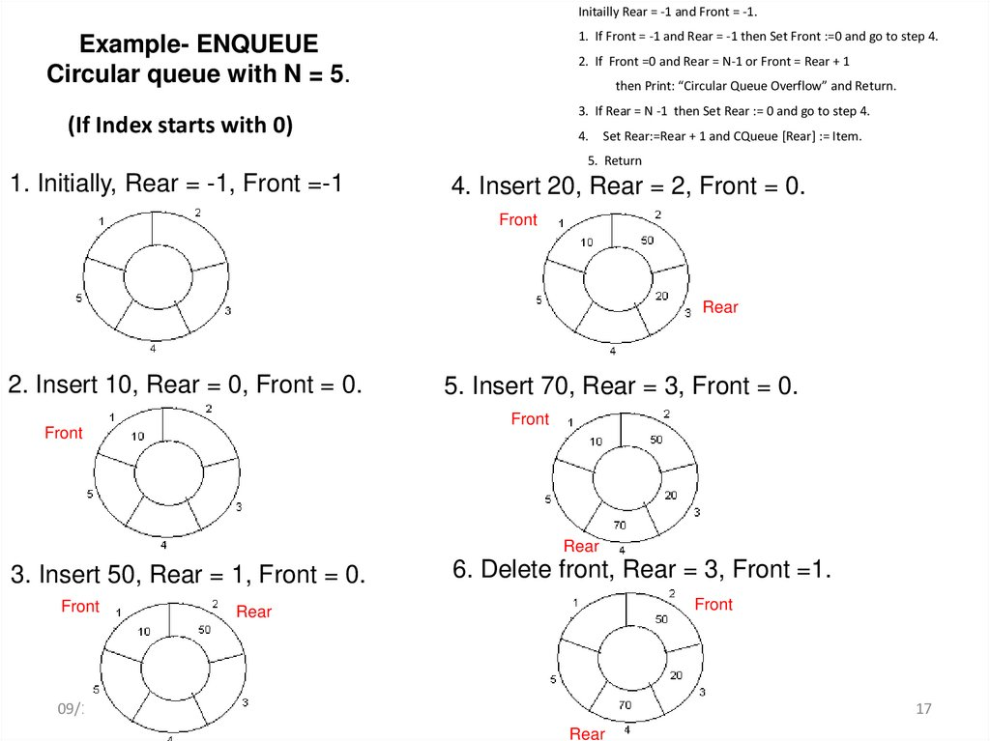
EXAMPLES

Slide 12
SELF-ASSESSMENT QUESTIONS
What is the primary difference between a linear queue and a circular queue?
A. Circular queue uses pointers, while linear queue does not.
B. In a circular queue, the last position is connected to the first.
C. Circular queue can grow dynamically, while a linear queue cannot.
D. Linear queue supports FIFO, while circular queue does not.
…
2. In a circular queue of size N, what condition indicates that the queue is full?
A.(Rear + 1) % N == Front
B. (Rear - 1) % N == Front
C. Rear == Front
D. Front == -1

Slide 13
TERMINAL QUESTIONS
1. Describe about a priority queue?
2. List out the difference between queue and priority queue?
3. Analyze applications of priority queue?
4. Summarize the operations of priority queue?

Slide 14
REFERENCES FOR FURTHER LEARNING OF THE SESSION
Reference Books:
1.
2.
3.
Sites and Web links:
1.
2.
3.

Slide 15
THANK YOU
BES– Data Structures

